Slide 1
Welcome
Enclosed in your folder, you will find:
PEAL postcard
Alternate Registration Form
Session Evaluation
Presentation materials
Since PEAL is federally funded, we must report demographic data to our funders.
Please take a moment to complete the PEAL forms in your folder.
Thank you!
Notes:
Have displayed as people enter the room for the presentation.
*If part of a conference, add the title to this slide. “Welcome to the PEAL Overview”

Slide 2
Introduction to the PEAL Center
Notes:
Handouts to take—place handouts where people can choose which they would like to take
PEAL postcard
PEAL newsletter-most recent
Medical Home Initiative Postcard
County Resource sheet—not all are completed yet, more info will be given
PA State Task Force Brochure
Special Education Resources in PA
Publications to hold up on Resource slide: NOREP, Friendship Toolkit booklet, Special Ed Resources for Families rackcard, Medical Home Initiative brochure, Stepping Stones (customize for audience, show array of resources from PEAL)
Alternate Registration Half sheets—if PEAL doesn’t do registration, plus a few for walk-ins
Evaluations

Slide 3
Participants will be able to:
List the services that PEAL provides
Describe how PEAL educates and empowers families, professionals, youth, and young adults
Access PEAL resources
Notes:
Participants will be able to: (read slide)

Slide 4
PEAL’s Mission
The mission of the PEAL Center is to educate and empower families to ensure that children, youth and young adults with disabilities and special health care needs lead rich, active lives as full members of their schools and communities
Notes:
Notes:
Pair/Share: have audience read mission statement and share what word or phrase resonates with you. (trainer: which resonates with you and why?)

Slide 5
What is the PEAL Center?
Parent Training & Information Center (PTI) and Family-to-Family Health Information Center (F2F)
PEAL services are provided at no charge to families due to federal funding and donations
Family-led organization
Serves the entire state of Pennsylvania
Notes:
PEAL is a non-profit organization made up primarily of parents and family members of children, youth and young adults with disabilities and special health care needs, as well as self-advocates.
Ask audience: How many of you are family members or self-advocates? How many are professionals? Others?
Each state has at least one Parent Training and Information Center (PTI) and PEAL serves as the PTI for all of PA.
IDEA mandates each state have a PTI to assist families with the special education system.
Our primary funding source is from the Office of Special Education Programs at the federal level. In addition, PEAL receives funds from the Federal Department of Health to serve as the Family to Family Health Information Center for PA. PEAL provides assistance and resources on these healthcare related topics: families as partners, early & continuous screening, access to medical home, insurance & funding, transition to adult care, and navigating systems & community services. More information on these topics is also available on our website.
We continue to reach over 30,000 people every year across Pennsylvania.
PEAL services are provided at no charge to families, as they are funded by federal, state, and private grants, as well as private donations.

Slide 6
How We Assist
Educate and empower families, youth and young adults up to age 26, and professionals who work with them
Equip with the tools needed to advocate for their children and themselves
Offer guidance in education and healthcare systems
Develop informed decision makers
Notes:
The PEAL Center exists today because a small group of parents, got together, brainstormed, and came up with a plan to educate their children with disabilities in a typical education setting, and reach other families across the state.
Being an informed decision maker is also a mandate from IDEA. In the latest reauthorization of IDEA in 2004, the word “parent” is included 197 times, and the supporting regulations include it 932 times.
Deeper dive:
**Everyone at PEAL has a story, touched by disability or special health care needs. What is yours?

Slide 7
PEAL Center Services
Outreach
Resources
Individual Assistance
Training
Leadership Development
Partnerships
Notes:
Notes:
The graphic represents the six key strategies used by PEAL to accomplish our work.
Families and Youth are the center of our work, surrounded by their communities and the professionals who work with them.
We will talk about each of these strategies in the following slides.

Slide 8
Reach families, youth/young adults, and professionals who would benefit from PEAL services
Engage underserved communities
Share information about PEAL and statewide services
Network with organizations
Build community connections
Interact on social media
Notes:
Notes:
We distribute information about services available and how to access them to families, professionals, youth and young adults.
We make sure to reach underserved communities to have information shared with them. These may be more rural areas, low-income, more diverse, or areas with lower literacy rates.
We partner with local organizations to bring information to a variety of audiences across the state.
We participate in community outreach activities, such as resource fairs, school district transition events, conferences, Local Task Force meetings, and other events.
If you are involved in a group that does any of these types of events, please feel free to let PEAL know about it!

Slide 9
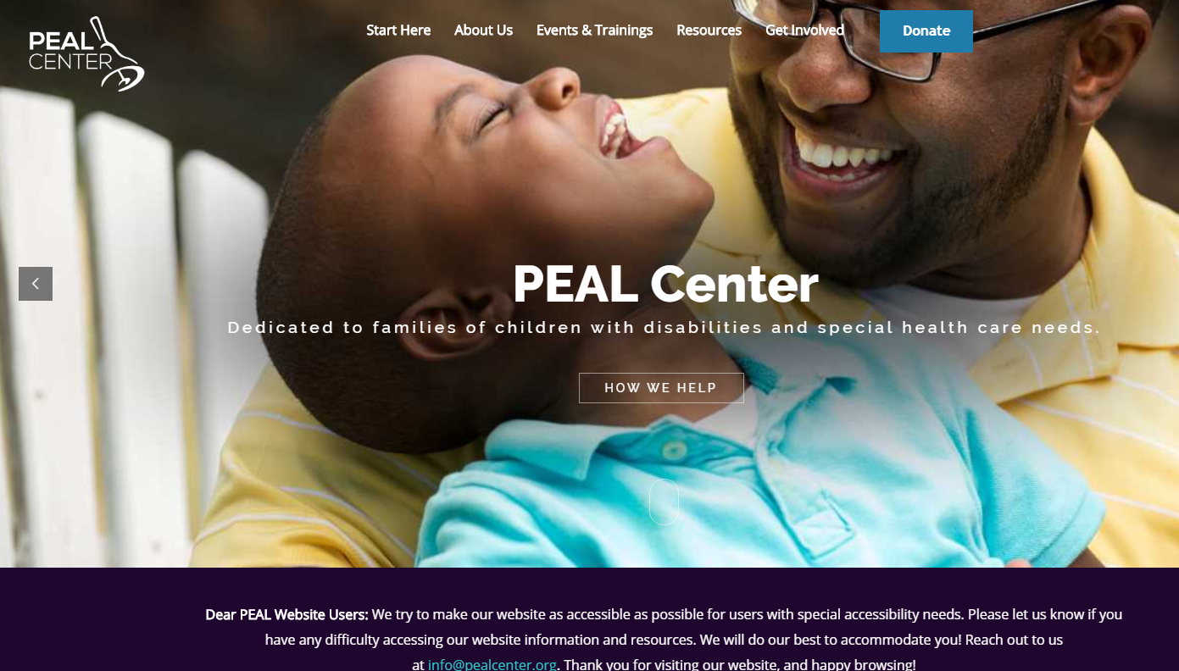
Develop and identify tools and materials to increase the knowledge and skills of families, individuals, and professionals
Available resources
Weekly e-blasts
Social Media
Newsletters
PEAL Website
Community Calendar
Notes:
Notes:
Resources are available online, or in hard copy if requested. (Show examples of resources)
Please join our distribution list, by either going to our website, or filling out the form.
Our website is user-friendly, can be translated into multiple languages with the click of a button, and is accessible to meet your needs. There is a drop down menu at the bottom of our homepage, at pealcenter.org, to select an alternate language.
If you would like to share an event on PEAL’s Statewide Community Calendar, add it through the link on our website.
A few examples of topics of resources:
Special education forms and processes
Transition to Adulthood
Youth
Friendship Toolkit
State and County resources
PEAL as an organization

Slide 10
INCLUSION
PEAL provides individual assistance to families, youth and young adults via phone and email to help them:
Review documents and provide resources
Prepare for meetings
Understand options for resolving disputes
Understand their rights and advocate for themselves
Be included & educated with high expectations at school and in their community
Access high quality, coordinated health care
Assistance available in Spanish and other languages
Notes:
Notes:
PEAL’s mission focuses on leading rich, active lives as full members of the school and community.
It is of critical importance that families understand that every student who has an IEP is entitled to a Free and Appropriate Public Education in the Least Restrictive Environment, and, that the first consideration for providing special education services should be in the general education classroom with typical peers.
One of the ways that PEAL accomplishes this mission is by providing individual assistance to families who have children with disabilities and special health care needs.
The special education and health care systems are often challenging to navigate, especially when families are new to these systems.
PEAL team members help families, youth and young adults to understand the rights that they have so that they can advocate for themselves. Special education is a marathon, not a sprint.
We support people to expect that children and youth with disabilities will be included at their home school, with appropriate supports provided so that all students have access to high quality education with high expectations for learning.
As youth begin transitioning to adult life, PEAL educates families, youth and young adults about effective transition planning that connects families to adult-serving systems so that their needs continue to be met once they leave school.
Families who need to address special health care needs get information, education and support to access high quality coordinated health care – both behavioral and physical health care needs are addressed.
PEAL team members work with individuals to understand the various documents that come along with special education, like Evaluation Reports, IEPs and NOREPs
We help to translate jargon and unfamiliar terms and identify questions that families want to ask at a meeting with a school or health care provider.
Generally, PEAL staff are unable to attend meetings in person. Under certain circumstances, for example, when English is not the parent’s first language, we may be able to attend on a case-by-case basis. Spanish speaking families are assisted by a bilingual Parent Advisor and we use real-time translators if families speak another language.
As we work with people, we often provide resources so that they can learn more about specific topics, such as positive behavior support or procedural safeguards.
Individual Assistance can be accessed by sending an email to info@pealcenter.org or calling the main number.
Every effort is made to return contacts within 24 hours.
Deeper Dive:
PA story
An F2F story
INFORMATION FOR PRESENTERS:
PEAL Criteria for attending meetings:
Family’s limited capacity to advocate on their own behalf, due to limited literacy, limited English proficiency, and/or disability of the family
Potential harm being caused to the child (e.g., child is out of school for a long time; use of restraints or aversives)
Either SD or parent sees no other option but due process; however, the situation seems like it can be resolved – set clear expectation that our attendance is to facilitate resolution

Slide 11
Provide training to families, youth/young adults, and professionals
Build knowledge of best practices and develop skills for navigating special education, health care, and transition to adulthood
Trainings offered in-person
Web-based presentations
Select trainings available in Spanish
Notes:
Notes:
Requests for trainings can be made through the PEAL website by clicking on Events & Trainings. They range from ½ hour overview presentation to full day mini-conferences
These are a few of the trainings PEAL offers:
Developing a Strong IEP
Evaluation/Reevaluation
Health literacy
Advocacy
Presuming Competence
Transition
Friendship Toolkit
Self-Advocacy
Full Day youth/young adult mini conferences
Spanish trainings available:
Developing a Strong IEP
Procedural Safeguards

Slide 12
Empowers families and youth/young adults to become leaders committed to improving education and healthcare systems
Provide intensive leadership workshops
Prepare to influence system-wide change
Local, county, state, or federal level
Participate on decision making groups
Youth leadership development
Mini-conferences on self-advocacy
Webinars on topics of interest
Youth Leadership Institutes
Notes:
Notes:
Leadership Workshops meet for about 30 hours over several sessions, and the goal is to give families and youth the tools and training they need to become leaders to effect change.
Participants learn how sharing their story can effect systems wide change.
Previous participants have gone on to become leaders in decision-making groups such as Local Task Force, Parent partners in Medical Home Practices, State Task Force, school boards, etc.
Youth mini conferences are typically a few hours and inform and encourage teens to become self advocates for increased independence.
**Activity- Reflect on this slide, share out where your strength lies, or what would be your barrier? (public speaking, belonging to a group, time?)
Deeper Dive: ( youth)
Why self advocacy is so important
1-gain the knowledge you need to succeed
2-have a chance to participate in decisions about your life
3-know how and when to ask for help
Do you understand how powerful your stories are?
Deeper Dive (families) Example of an elevator speech? *Tammi example of elevator speech*

Slide 13
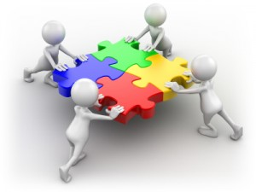
Establish active partnerships
Build bridges across agencies/organizations and systems
Education
Healthcare
Advocacy and family groups
State, local and national agencies
Connecting supports to strengthen community inclusion
Help effectively access services
Improve person-centered outcomes
Notes:
Notes:
Primary reason PEAL builds partnerships is to bring the family voice to decision making bodies.
Some of the partnerships that PEAL has currently are with:
Bureau of Special Education
PA Department of Health
PA Medical Home Initiative
Pennsylvania Training and Technical Assistance Network (PaTTAN)
Pennsylvania Youth Leadership Network
National Alliance on Mental Illness (NAMI)
Intermediate Units
Special Education Advisory Panel
Hispanics United for Exceptional Children (HUNE)
Professionals learn from families as much as families learn from professionals.
Deeper Dive:
We partner with the Department of Special Education, PaTTAN, and HUNE in initiatives for professional development for educators.
These partnerships is deeply committed to capturing the family perspective. One powerful example is FAMILIES TO THE MAX: Pennsylvania Statewide Family Network (F2MAX), a grassroots network of families and professionals dedicated to ensuring that all children have access to the general education curriculum.

Slide 14
Questions?
Notes:
Review statement-what you learned, did we meet the objectives?
List the services that PEAL provides
Describe how PEAL educates and empowers families, professionals, youth, and young adults
Access PEAL resources
6 ways we can help
Time for Q & A
Please fill out the evaluation before you leave. If you would like additional information or support from PEAL, please note that on your evaluation.

Slide 15
Thank you!
www.pealcenter.org
info@pealcenter.org
1-866-950-1040
Serving families across PA with offices in Pittsburgh and Philadelphia

